Slide 1
WATER POLLUTION
SNEHA GUPTA
2021UCA1859

Slide 2
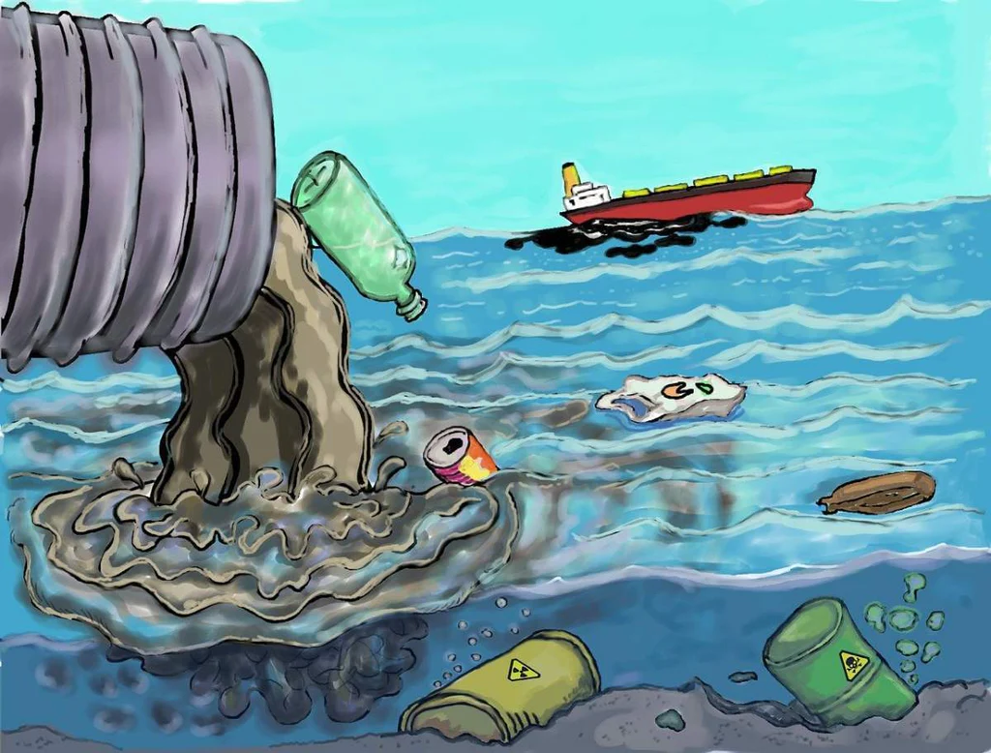
WHAT IS WATER POLLUTION
Water pollution is the contamination of water bodies, usually as a result of human activities, so that it negatively affects its users.
Water pollution can also lead to water-borne diseases for people using polluted water for drinking, bathing, washing or irrigation. Water pollution reduces the ability of the body of water to provide the ecosystem services (such as drinking water) that it would otherwise provide.
Introduction

Slide 3



WATER POLLUTION can be attributed to one of three sources:
Industrial activities,
Agricultural activities,
Urban runoff including stormwater.

Slide 4
Ecosystems
Public health and waterborne diseases
Eutrophication from nitrogen pollution
Ocean acidification
Water pollution is a major
global environmental problem
because it can result in the
degradation of aquatic ecosystems.
polluted water spread
gastrointestinal diseases
and parasitic infections and
killed 1.8 million people
affects.
Nitrogen pollution can cause eutrop-
hication, especially in lakes. Eutrop-
hication is an increase in the concentr-
ation of chemical nutrients in an ecos-
ystem to an extent that increases the
primary productivity of the ecosystem.
Ocean acidification is
The ongoing decrease in
the pH value of the
Earth's oceans.

Slide 5
Control and reduction
Pollution control philosophy
Sanitation and sewage treatment
Industrial wastewater treatment
Agricultural wastewater treatment
Management of erosion and sediment control
Treatments to control the water pollution

Slide 6
THANKYOU

